Slide 1

Micro-Credit Defaulter Model
By,
Vijay Rodrigues

Slide 2
Problem Statement:
A Microfinance Institution (MFI) is an organization that offers financial services to low income populations.
In our case an MFI with the association with one of the telecom operators of Indonesia is offering loan / financial assistances to low income families to help them buy budget friendly products and reduce the expense to some extent.
The Consumer is believed to be defaulter if he /she deviates from the path of paying back the loaned amount within the time duration of 5 days.
For the loan amount of 5 (in Indonesian Rupiah), payback amount should be 6 (in Indonesian Rupiah), while, for the loan amount of 10 (in Indonesian Rupiah), the payback amount should be 12 (in Indonesian Rupiah).
We are required to build a model that can predict the loan amount paid within 5 days (non-defaulter) and the amount paid after 5 days (defaulter) as they are liable for fine as mentioned above.

Slide 3
EDA Steps / Data Pre-processing Done
Acquire the dataset
We have received this dataset from FlipRobo Technologies which is related to a Micro Finance bank supporting Telecom sectors in Indonesia.
The sample data is provided to us from our client database. It is hereby given for this exercise. In order to improve the selection of customers for the credit, the client wants some predictions that could help them in further investment and improvement in selection of customers.

Slide 4
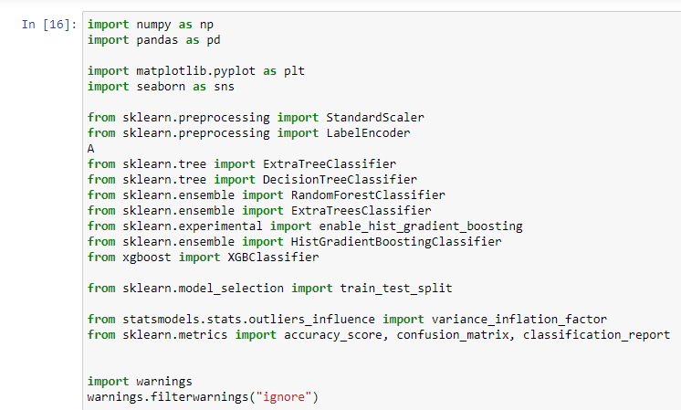
2. Import all the crucial libraries
For this project I have used the following major libraries like Pandas-profiling, Pandas, Matplotlib and Seaborn that are used for EDA or any other pre-processing done in this scenario.

Slide 5
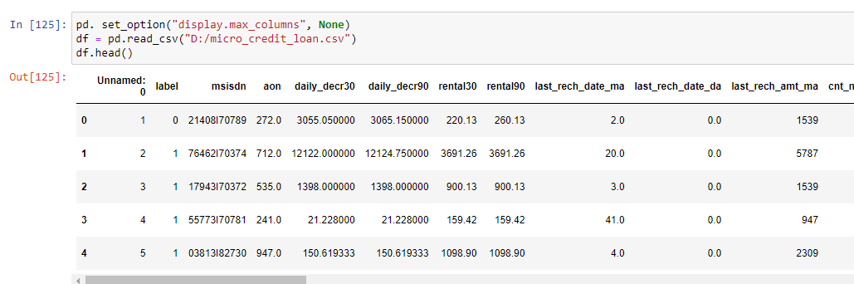
3. Import the dataset
The dataset is in CSV format and it is imported using Pandas library in Jupyter Notebook.
The statement pd. set_option("display.max_columns", None) simply allows us to physically see all the feature columns.
By default, Jupyter Notebook doesn’t display all the rows and columns at the same time and only selected portion from starting and ending of dataset are displayed.

Slide 6


4. Identifying and handling the missing values
The column "Unnamed: 0" has no significance of any kind.
It's just a serial number which is same as the index number and hence this column is dropped in the beginning itself.
column "msisdn" is the mobile number of the person and it doesn't really add any value in the analysis as well hence it's dropped.
The dataset appears to have a total of 209593 records (rows) and 35 features (columns) including 1 target column "label"
I have not considered year to be split because this dataset by default is for the year 2016 and has no other years included.

Slide 7
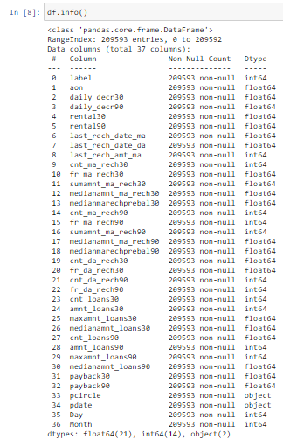
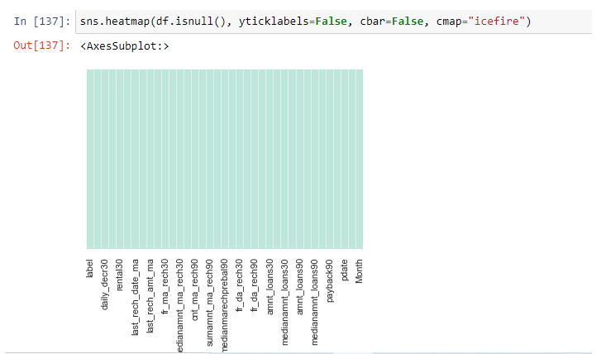
The dataset appears to have all the information intact and as 209593 non-null out of 209593 rows.
We have a total of 21 float64 features, 14 int64 type features and 2 object type features.
We don't have any null / missing values in any columns.

Slide 8
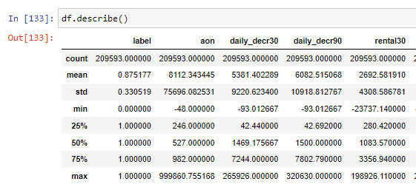
But if we observe, the std values are higher than the mean values for almost all the features and it's not correct.
We can assume that some human error may have happened and due to this we surely will find a lot of outliers and skewness in dataset.
Since it's a Bank dataset, there could be a possibility where certain number is actually genuine but all the features with similar issue is likely impossible just by coincidence and the data may not be accurate as seen.
For Eg: if you consider column "aon" we have values from min increasing gradually with some gap which is similar as it approaches higher quartiles, but the max value for the same is suddenly jumped to 999860.75 which is not accurate.
It's same for majority of features if not all and we have to reduce the outliers.

Slide 9

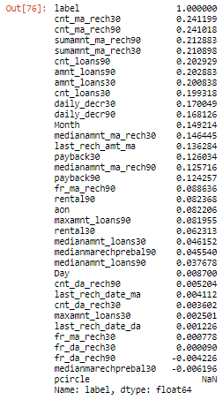

By splitting the date column to "Day' and "Month" the results were effective. Hence this "pdate" column is dropped as it will be a redundant column.
Correlation of the features with the dependent variable "label“
We can observe that "cnt_ma_rech30", "cnt_ma_rech90", "sumamnt_ma_rech90", "sumamnt_ma_rech30", "cnt_loans90", "amnt_loans90", "amnt_loans30", "cnt_loans30", "daily_decr30", "daily_decr90", "Month", "medianamnt_ma_rech30", "last_rech_amt_ma", "payback30", "medianamnt_ma_rech90" and "payback90" seem to have a strong correlation with the output variable.

Slide 10
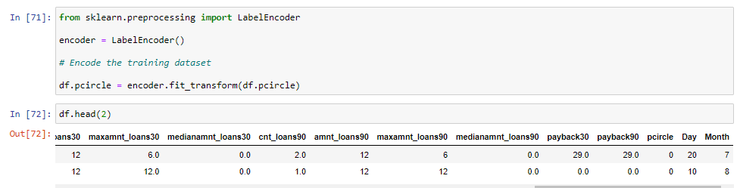
5. Encoding the categorical data
I have used LabelEncoder as the data is categorical and is not ordinal in nature.
The column "pcircle" is converted into its corresponding numerical value.

Slide 11

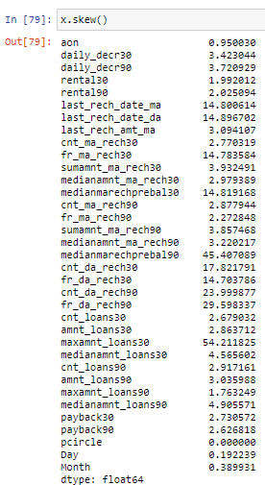
6. Splitting the dataset
Splitting up of dataset between x (features) and y (target column).
We can see majority of features have skewness and since we could not remove outliers, let’s try to reduce skewness to some extent if possible.
Split the dataset into train and test data set.
I have chosen 200 random state and 30% of data is divided in text dataset.

Slide 12
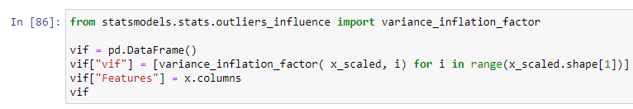
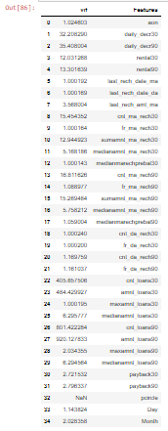
7. Feature scaling
Finding variance inflation factor in each scaled column.
This gives us relationship between feature vs feature and we can drop if necessary to avoid multicollinearity.
From the below observation, we can find many variables that have VIF and I have not considered dropping these columns as data is dynamic and every value seemed important.
Also without dropping the features I got even better accuracy in the final model.

Slide 13
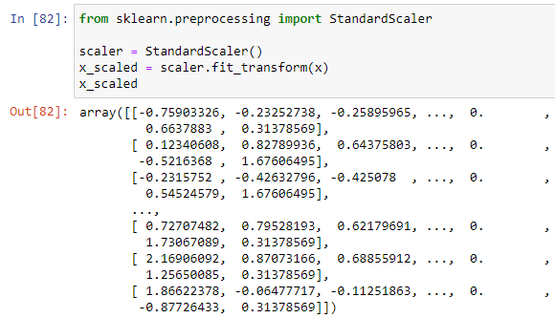
8. Standardization / skewness removal
Let’s us now Scale the data for further processing.
we have used StandardScaler for further scaling up of data

Slide 14
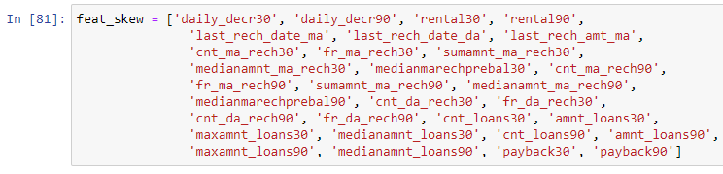
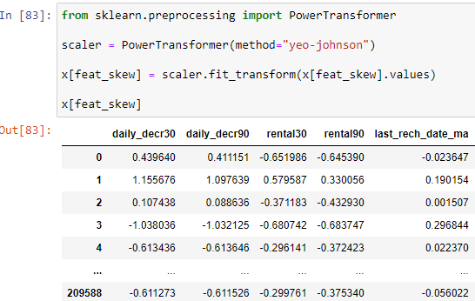
Storing the list of features having skewness in a variable "feat_skew". It's would be easier to pass it through at one go.
Power Transformer (yeo-Johnson).
To reduce the skewness to some extent, I have used a Power Transformer technique.
Since we have both positive and negative values in skewness, I have used "Yeo-Johnson" technique.
The data is further standardized to some extent.

Slide 15
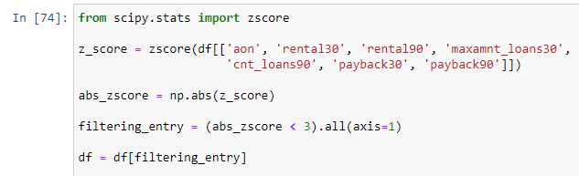
Data Inputs- Logic- Output Relationships
The dataset has predefined values in numerical format as majority of the dataset has both continuous and discrete data.
But the output variable “label” is in categorical format and hence this dataset is a classification problem.
The outliers are removed using z-score and only few features are selected to keep the threshold within 7 to 8% of data loss.
The following columns 'aon', 'rental30', 'rental90', 'maxamnt_loans30', 'cnt_loans90', 'payback30' and 'payback90' are considered for outlier removal.

Slide 16
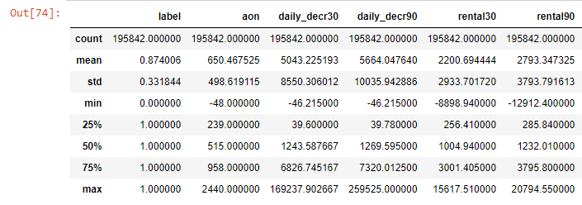
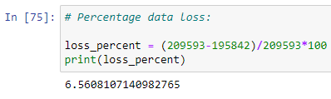
It is told that if the data loss is more than 7 to 8%, we may not get accurate results. In this case the data is reduced to approximately 6.5% after applying z-score.
If all columns were used for outlier removal there would have been approximately 22% of data loss which is very high. Also, by considering 6.5 % data loss dataset, I have been able to achieve a better model in the later stage.

Slide 17
Assumptions considered
There are no null values in the dataset.
There may be some customers with no loan history.
The dataset is imbalanced. Label ‘1’ has approximately 87.5% records, while, label ‘0’ has approximately 12.5% records.
There are multiple outliers in majority of the features which if removed in entirety we would lose data up to 22%.
Keeping in mind that data is expensive and we cannot lose more than 7-8% of the data and models are built based on this scenario only.

Slide 18
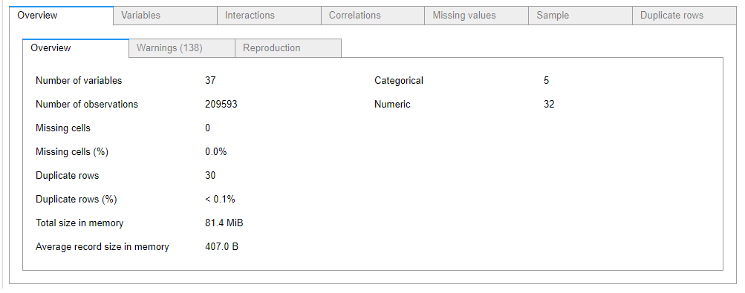
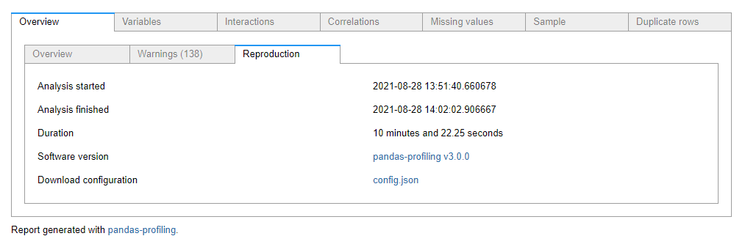
Explore the dataset with Pandas Profiling
Visualizations
The following screenshot given us overall understanding about the dataset.
It gives us the type of features, total features, what features are categorical or numerical etc. Basically this window is a combination of all the options available on the plot.
If you select “Reproduction” option we can see relationships or information on time taken to run this code.
In this case, it’s taken approximately 10 minutes to run this dataset under pandas profiling. It’s depends on the type of dataset, size of dataset and also on the system one uses to run these plots and models.

Slide 19
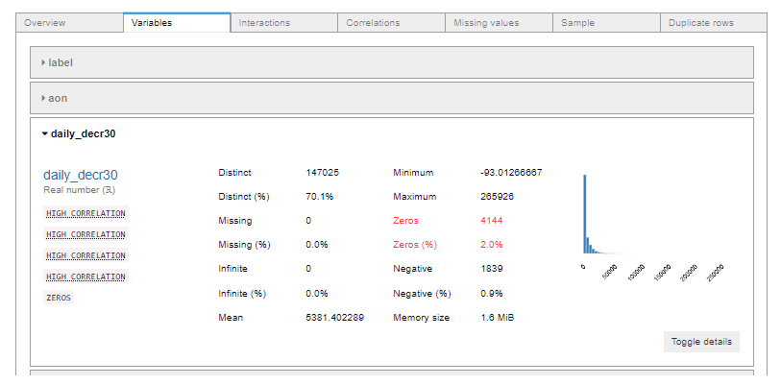
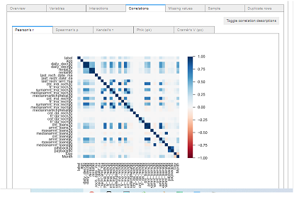
If you select “Variables” option we can see relationships or information on individual value or feature.
In the screenshot to the right we can see the information related to the feature “daily_decr30”.
The screenshot to the left shows us the correlation of the dataset.
Pandas profiling supports almost 4 to 5 correlation techniques and the following is Pearson correlation.

Slide 20
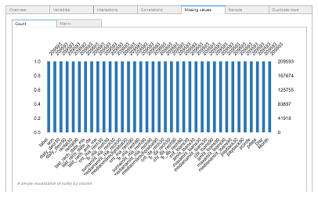
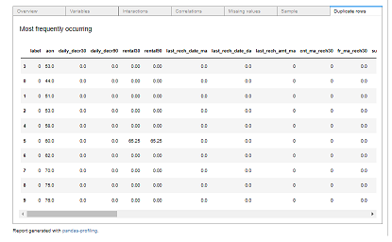
The “missing values” option by name gives us details of any missing data for all the features of the dataset.
In this case we do not have any missing values a shown below.
The “Duplicate Values” option by name gives us details of any duplicate values in the dataset.
It’s confusing to understand as the systems considers any repeated value in a row as duplicate value.
In real world datasets such data is likely to occur when a number, count etc could be same.

Slide 21
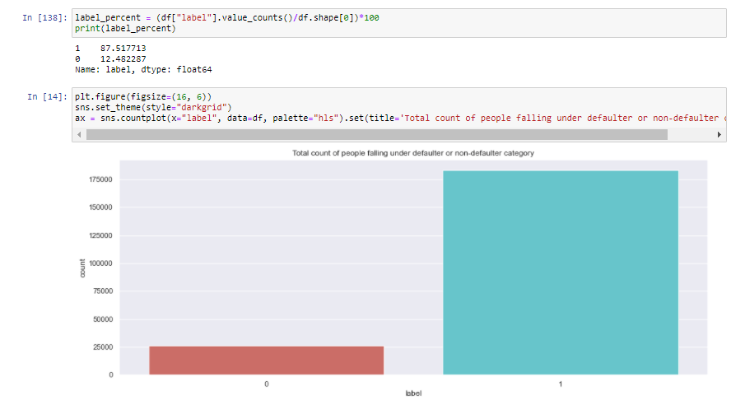
Let's observe the relationship between the defaulter and non-defaulters.
Customers that have paid back the loaned amount within 5 days of insurance of loan are "non - defaulters" and if they haven't then they are "defaulters",
We can see that approximately 87.5% of customers have paid back and remaining 12.4% of customers are considered "defaulters",
This also tells us the dataset is highly imbalanced and we may have to take necessary steps to overcome this.

Slide 22
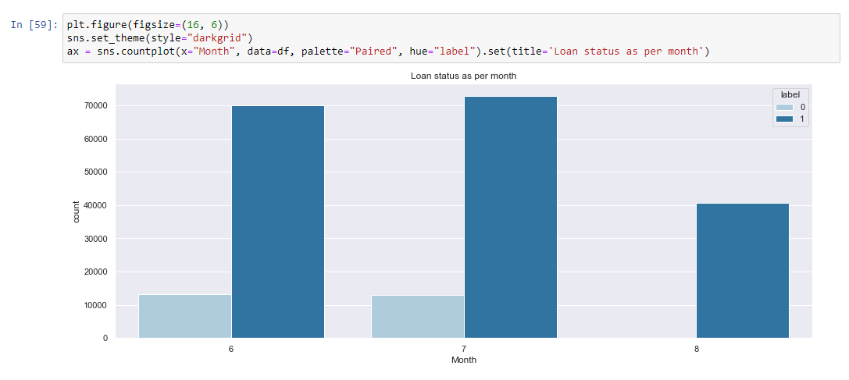
From the below plot, we can see that we have data for the months June, July and August and in general the outstanding loan amount count is less compared to the ones who have paid.
Also for the month of August we can see there is no defaulted amount but also the total loan received seems to be less in count.
Either the data is as is or data was only for half of August month.

Slide 23
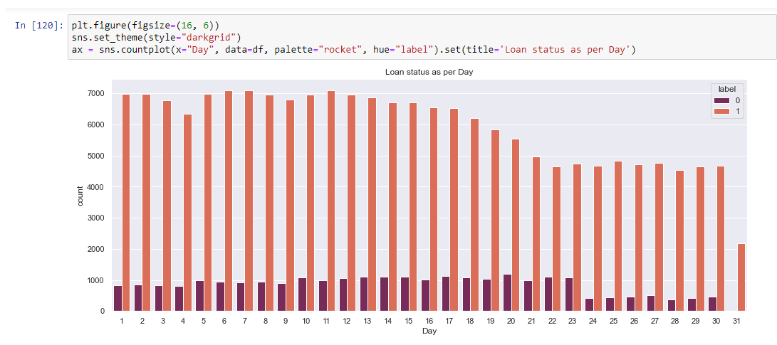
From the below plot we can see the count of days and status of loan amount.
We can observe that from day 1 to 17 the payment of loan seems consistent and after 17th the inflow of loan amount seems to have reduced and is on same scale. Maybe customers are likely to pay in the first 2 weeks and as the month end approaches the pattern seems to change.
We can observe in this plot for 31st day we have less count of inflow. This shows that majority of customers pay within the month except for few customers.

Slide 24
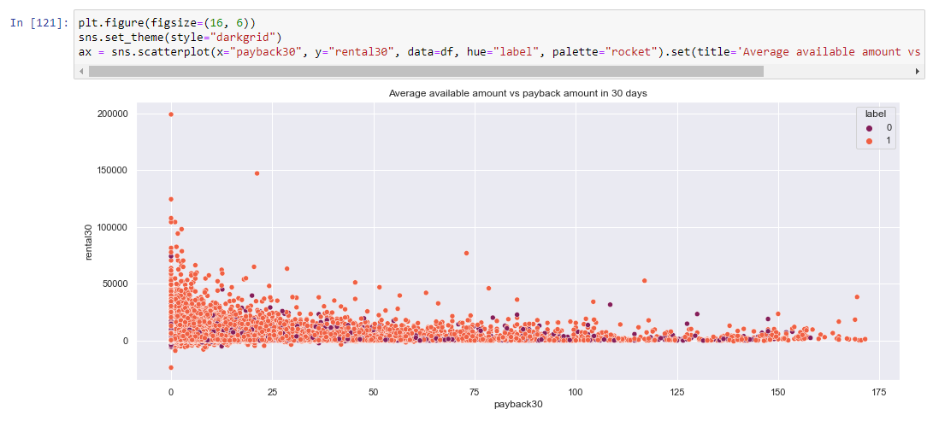
Lets now observe the pattern of payback of loan amount in 30 days.
We previously observed that majority of people pay within month and some of them even on the last day of the month. From the below plot we can observe that as and when their payback amount is increased, their average account balance also gets decreased except for a few observations where they appear to be outliers.
Since the average balance amount itself is less, repayment becomes a chaos but still very few customers have ended up defaulting and majority of them have already paid the loan amount.

Slide 25
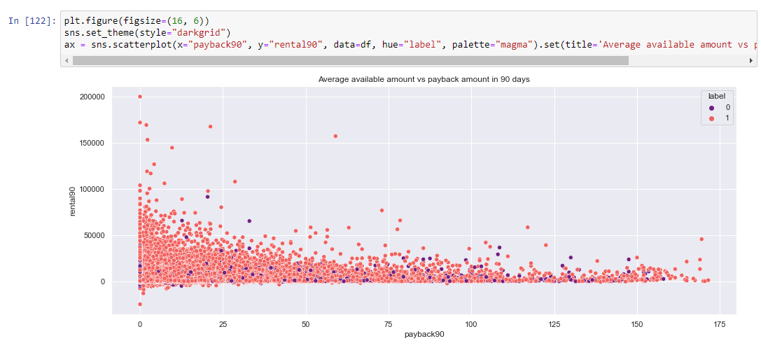
Let's see if the same pattern applies in the case of 90 days payback period.
From the plot, the distribution of amount seems as same as amount taken in 30 days but majority of customers seem to fall in category between 0 to 50000 Rupiah at least. Also the outlier amount appears in the initial stages compared to later stages. Maybe customers start filing in their account initially through salary etc hoping to return the amount as much as possible and also trying to keep the account balance above average.
Also just like in payback 30, here also customers prefer paying as early as possible and delay in payment is as same as in 30 days.

Slide 26
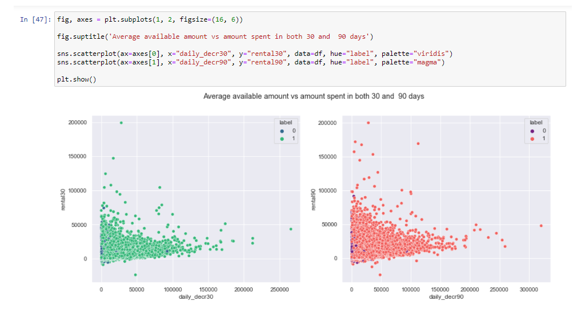
The following subplot gives us decrease in amount for both 30 and 90 days and how much of average amount balance is left post that.
We can see that although defaulters are quite less as per plot, in case of 90 days we can find more defaulters compared to 30 days plot.
Here also we can see outliers more in case of 90 days plot. But they gradually decrease as the account balance is reduced. But in plot 1, outliers are scattered throughout.

Slide 27
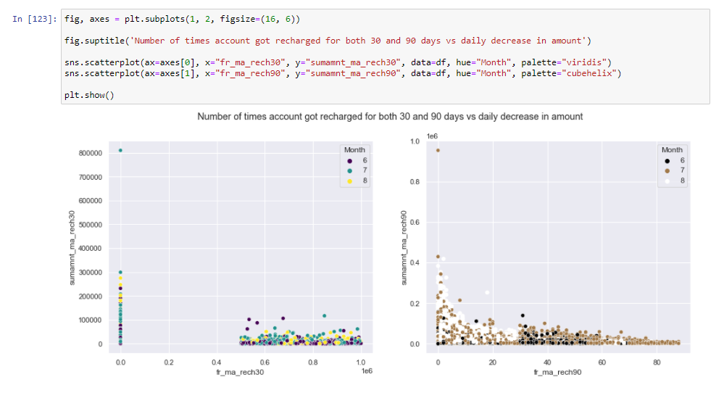
From the below plot we can see how frequent customers recharge / or add amount to the account. From 1st plot we can see those customers either recharge in the 2nd month i.e., July compared to June or August.
Also, the frequency of recharge seems to reduce in the last month i.e., August. We can also see there are a few customers right in the beginning who may not have recharged at all.
From the 2nd plot we can see a person taking 90 days loan, then July and August months seems to have high frequency of recharges done and customers that are paying even at the end of July month have account balance managed till the month end.

Slide 28
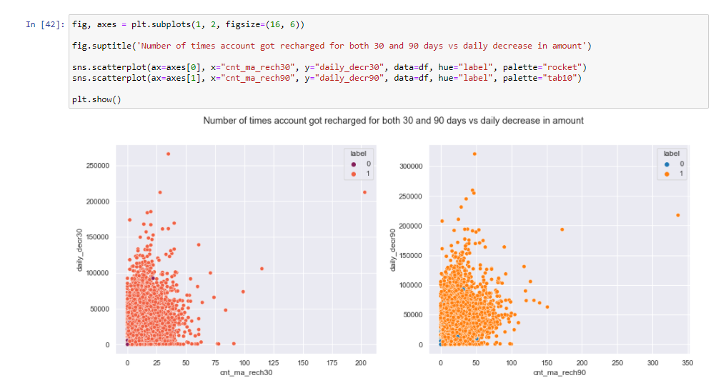
From the below plot the daily decrease of account balance is in relation with number of times the account got recharged
We can see that the more the number of times account got recharged, the less amount started to decrease. This makes sense and it's similar to both 30 days and 90 days.
We can see the majority of outliers lie in the range 1,50,000 to 2,70,000 Rupiah and defaulters’ counts are also minimum is both cases.

Slide 29
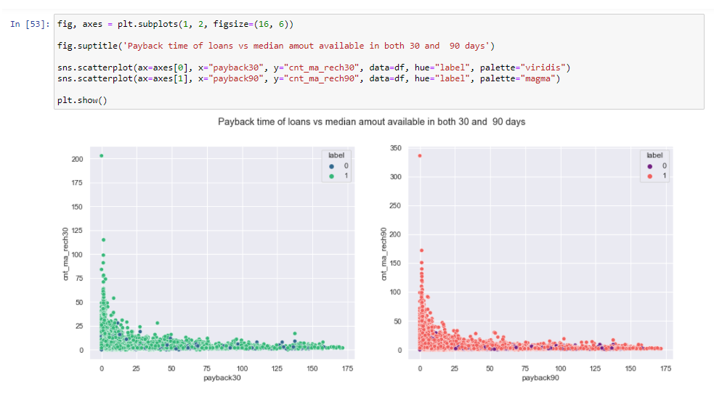
The below plot shows us the pattern of payback for both 30 days and 90 days with regards to recharge of amounts.
We can see from subplots for both the plots it's consistent. If loan amount / recharge is taken then it's paid immediately in both the cases and few numbers of customers seem to fall under defaulter category.

Slide 30
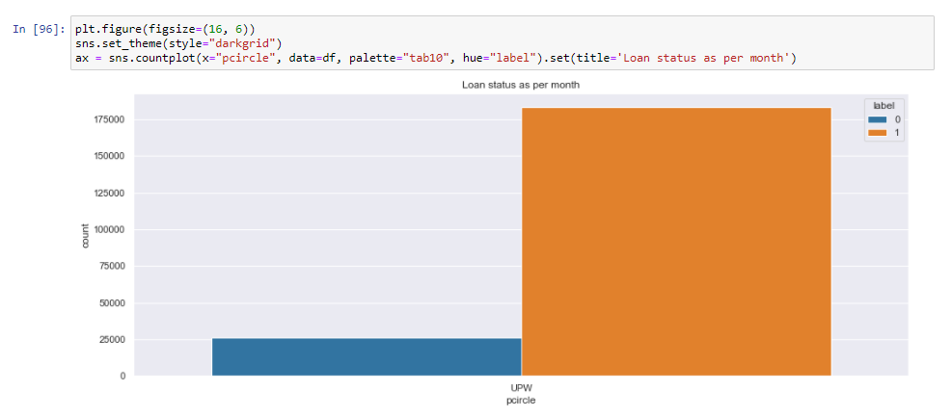
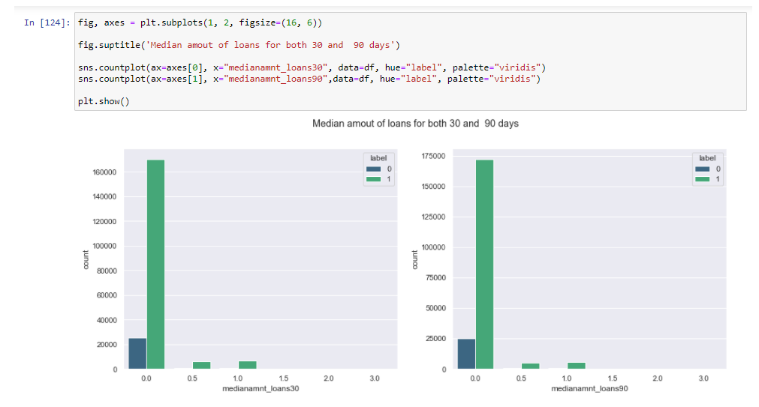
The following plot on the right side shows us the telecom circle that is associated with the MFI institutions. In this case its only UPW which is one of the telecom providers of Indonesia.
From the below plot we can see there is no much difference in the median amount of loan taken in both 30 and 90 days and with minor variations with respect to default loans.

Slide 31
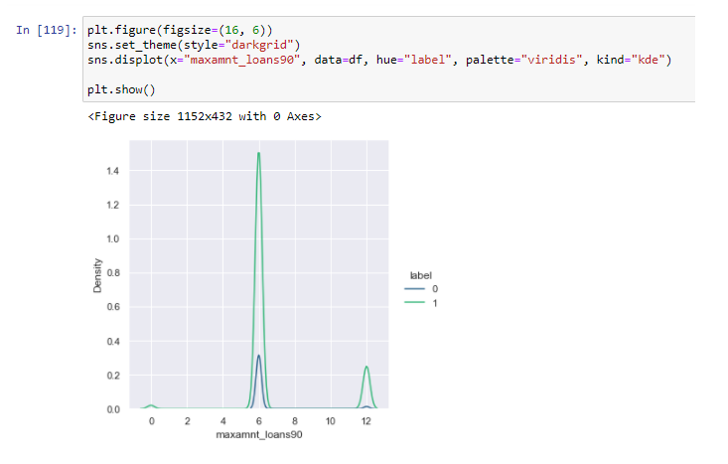
From the following plot we can observe the maximum amount returned is 6 Rupiah and 12 Rupiah.
This shows that this amount was paid as a fine for defaulting the payment by long time or simply because they delayed it by 5 days.
Since the bulge is high at Rupiah 6 because the amount recharged was Rupiah 5 compared to Rupiah 10. Not many people prefer getting recharge of more amount hence we can find customers with Rupiah 5.

Slide 32
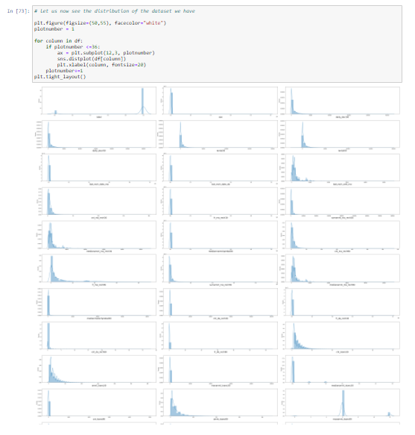
Majority if features are not normally distributed. Since we have multiple features, let’s try to identify the distribution.

Slide 33
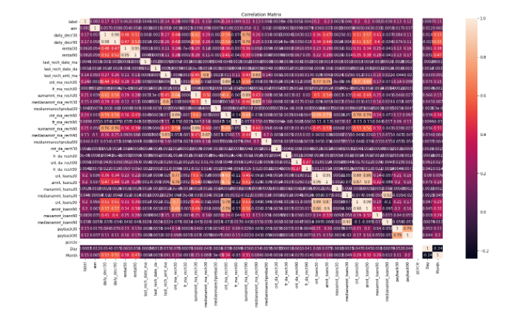
Let’s us now examine correlation using a "heatmap" for further clarification
Since there are multiple features, going through this plot may seem difficult.

Slide 34
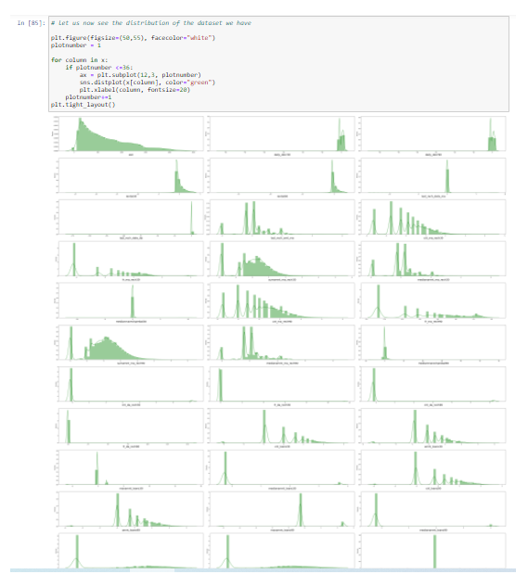
Distribution after skewness is removed to some extent.

Slide 35
For the model building I have considered the following 6 algorithms for the training and testing.
ExtraTreeClassifier
DecisionTreeClassifier
RandomForestClassifier
ExtraTreesClassifier
HistGradientBoostingClassifier
XGBClassifier

Slide 36
Run and Evaluate selected models
I have used a total of 6 machine learning algorithms to find the best and suited model which also includes ensemble algorithms.
I have used all 4 metrics i.e Accuracy, Precision, Recall and AUC-ROC for all the algorithms.
But we cannot simply rely on these scores as we cannot have any scope for assumption. Hence post this I have also performed Cross Validation for all these algorithms to find the estimated performance metric when it’s actually used in production.

Slide 37
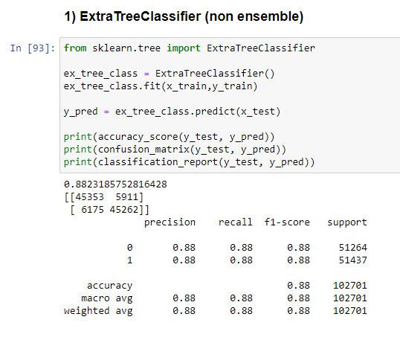
1) ExtraTreeClassifier
From the below algorithm we can see the accuracy score for ExtraTreeClassifier is approximately 88.23% better.
Precision, Recall and f1-score are also used as a part of confusion matrix

Slide 38
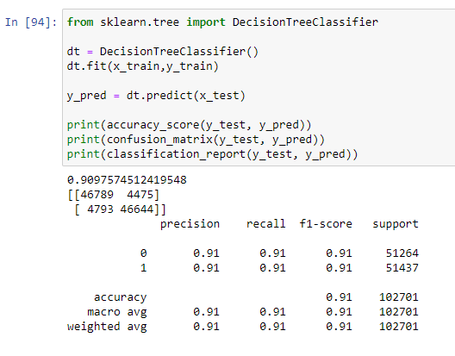
2) DecisionTreeClassifier
From the below algorithm we can see the accuracy score for DecisionTreeClassifier is approximately 90.97% better.
Precision, Recall and f1-score are also used as a part of confusion matrix.

Slide 39
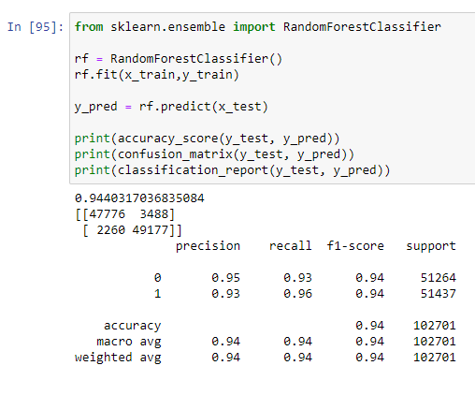
3) RandomForestClassifier
From the below algorithm we can see the accuracy score for RandomForestClassifier is approximately 94.40% better.
Precision, Recall and f1-score are also used as a part of confusion matrix.

Slide 40
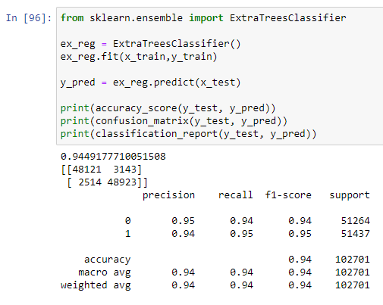
4) ExtraTreesClassifier
From the below algorithm we can see the accuracy score for ExtraTreesClassifier is approximately 94.49% better.
Precision, Recall and f1-score are also used as a part of confusion matrix.

Slide 41
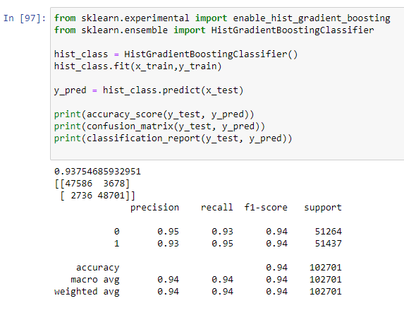
5) HistGradientBoostingClassifier
From the below algorithm we can see the accuracy score for HistGradientBoostingClassifier is approximately 93.75% better.
Precision, Recall and f1-score are also used as a part of confusion matrix.

Slide 42
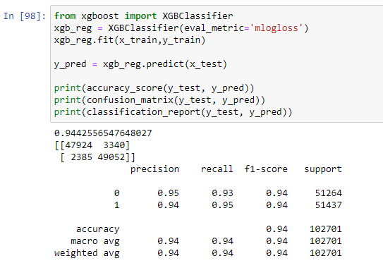
6) XGBClassifier
From the below algorithm we can see the accuracy score for XGBClassifier is approximately 94.42% better.
Precision, Recall and f1-score are also used as a part of confusion matrix.

Slide 43
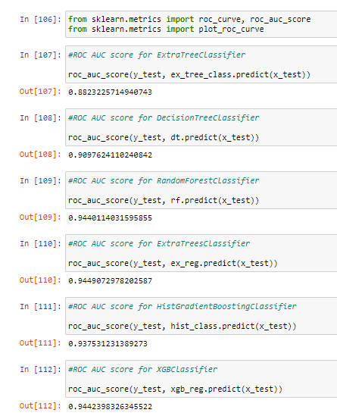
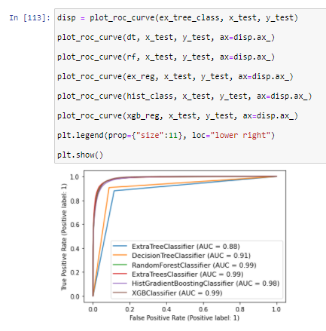
AUC - ROC
AUC – ROC plots are also mapped for further clarification as below.

Slide 44
AUC - ROC

Slide 45
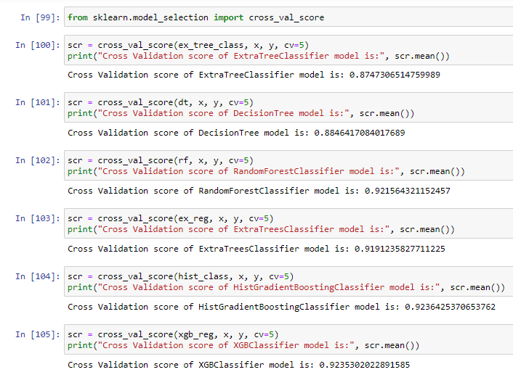
Cross Validation
The below code shows us the cross validation performed over all the algorithms and I have used the CV values as 5.
If you observe the below screenshot, we get the difference in the values.

Slide 46
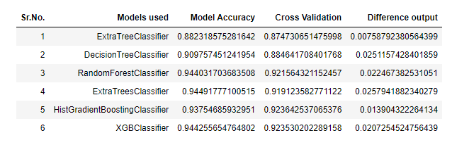
Model Selection
From the above algorithms ExtraTreeClassifier seems to be an ideal algorithm in this scenario and for this type of dataset.
The difference between the accuracy score and cross validation for this model is very less compared to other models.

Slide 47
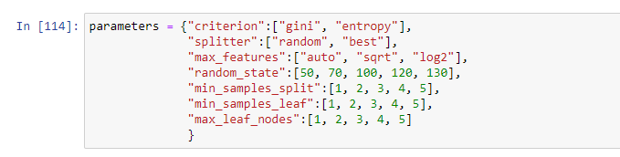
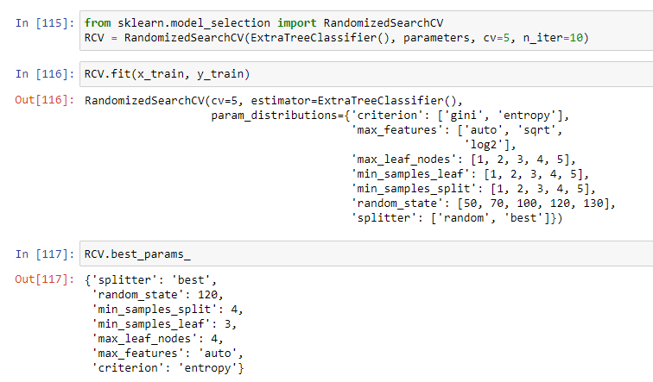
Hyperparameter Tuning
Let us try to tune the proposed model (ExtraTreeClassifier) to get better accuracy, if possible.
The "parameters" have been selected from the skicit library and I have considered 7 parameters.
RandomizedSearchCV is used to tune the parameters by fitting the same to the training dataset and used the best parameters after selection.

Slide 48
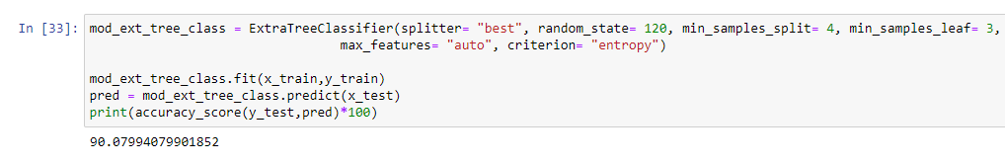
Final Model ( post Hyperparameter Tuning)
Rebuild the model using the appropriate params we received from best_params_
It’s observed that the model accuracy was approximately 88.23% earlier and post Hyper Parameter tuning its now approximately 90.07% better.

Slide 49

Model Dashboard
With the help of python library explainerdashboard I have managed to create a final model dashboard for your reference.

Slide 50





Slide 51
Learning Outcomes of the Study in respect of Data Science
With the help of this dataset, I was able to work on multiple classification algorithms and also got to work on large real-world dataset.
I also got some understating on how a company would provide datasets and not necessarily datasets are perfect all the time.
I realized the importance of working on datasets that have too many outliers and we have to take a decision whether we need to remove those completely or not.
I built multiple models several times where in one scenario I have considered model with 22% data loss, in one scenario I have considered model by dropping columns based on Variation Inflation Factors.
At one point I got into confusion if I need to consider only continuous or also discrete values for outlier and skewness removal and upon confirmation and doubt clearance from my SME I got better understanding about this dataset.
But the final model was considered that gave better accuracy after hyper tuning and model with 7 to 8% data loss is an ideal model.

Slide 52
Limitations of this work and Scope for Future Work
This dataset has multiple outliers and since based on management’s advice only up to certain percent of outliers are removed, I am not able to predict how this model would give output on different type of similar datasets.
Also this dataset contains information only for 3 months of the year 2016 and I believe having at least an annual information can help in formulating even better approaches.
As per one of the articles I referred to, the government is investing heavily in Spectrum Holding, IoT Markets and Digital Infrastructure (Fibre, Telecom Towers, Data Centres, Submarine Cables) are being innovated in Indonesia as part of 2021 to 2026 (5-year plan project).
Due to this there are multiple Telecom operators offering similar or better financial assistance due to the availability of 5G, M&A and e-Commerce.
Since this dataset is of the year 2016, I think due to lot of changes there could be some or major impacts in how prediction would work.

Slide 53
Thank You…

